Slide 1
PROJECT TITLE SECURE DATA HIDING IN IMAGES USING STEGANOGRAPHY
SECURE THE DATA TO PREVENT HACKERS
Presented By:VISHAL
Student Name : DABBIRU VISHAL
College Name & Department : KAKINADA INSTITUTE OF ENGINEERING &TECHNOLOGY

Slide 2
OUTLINE
Problem Statement
Technology used
Wow factor
End users
Result
Conclusion
Git-hub Link
Future scope

Slide 3
Problem Statement
Challenge:
The need for secure communication in an era of increasing digital surveillance and data breaches.
Objective:
To explore how steganography can be used to protect sensitive information from unauthorized access.
It is used to store the secret message in a image. Only with the help of secure key we can unlock the secret message from the image
It is used to secure the secret message from the unauthorized members, and to provide security to the secret message

Slide 4
PROJECT OVERVIEW
This project implements a steganography technique to securely hide and reveal secret within an image using the RGB color mechanism and a key based XOR operation for encryption. Steganography allows for concealing messages within non-secret text or data, ensuring secure communication by embedding sensitive information within an image in a way that is imperceptible to unauthorized viewers.
Image Encoding: Secret text is hidden within the image’s pixel values using the LSB method, with additional security provided by XOR the text characters with a user-provided security key.
Pixel Manipulation: The encoded text is distributed across the image’s pixels, maintaining the visual integrity of the image while embedding the hidden message.
Text Decoding: The project includes functionality to decrypt and retrieve the hidden text from the image using the correct security key, ensuring that only authorized users can access the information.
This project demonstrates a practical application of steganography for secure communication, embedding and retrieving secret messages within images in a secure and efficient manner.

Slide 5
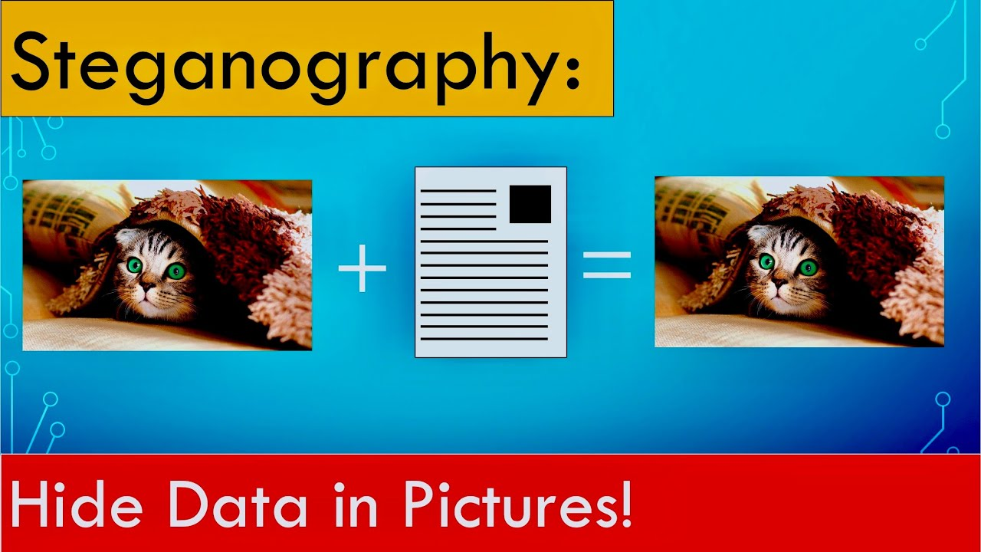
AGENDA
The agenda of this project to send a secret text to higher officials using the steganography concept and RGB technique, ensuring that criminals or others cannot identify the image or its hidden content. Thos project will involve encoding the secret text into the least significant bits of the image’s pixels, making the alterations imperceptible to the human eye. Additionally, a secure key-based XOR operation will be used to enhance the security of the hidden message. Finally, the project will include a robust mechanism for decoding and retrieving the hidden message, ensuring that only authorized personnel with the correct key can access the concealed information.

Slide 6

Hiding a text inside an image using steganography
An officer in danger requires a method to send a secret text message without alerting nearby criminals to his higher officials. Traditional communication methods are easily intercepted or monitored, so, he his necessitating a covert technique to embed and transmit critical information securely to his higher officials.

Slide 7
Technology used
Techniques:
Least Significant Bit (LSB) Insertion:
Modifying the least significant bits of pixel values in images.
Transform Domain Techniques:
Hiding data in frequency domains (e.g., DCT in JPEG images).
Tools:
Software like Steghide, OpenStego, Open cv and custom scripts for embedding and extraction.

Slide 8
Wow factors
Innovative Applications:
Digital Watermarking:
Protecting copyright by embedding watermarks in images and videos that are imperceptible to the human eye but detectable by software.
Covert Communication:
Use of steganography in social media platforms to send hidden messages within images, allowing for secure communication in public forums.
Data Integrity:
Ensuring that data has not been tampered with by embedding checksums or hashes within files.
Surprising Facts:
Steganography can be used in various fields, including journalism, to protect sources by hiding messages in published images.

Slide 9
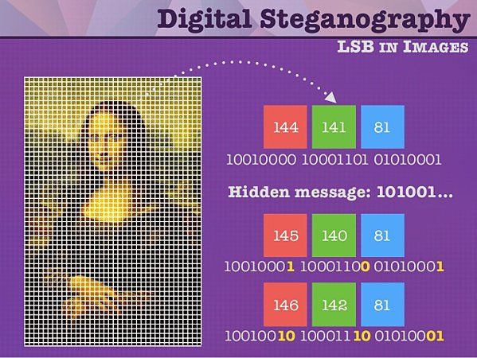
How did you customize the project and make it your own
By using problem statement this project is created to hide a text inside an image using RGB, LSB method is used for imperceptible to the human eye. And here XOR operation is used for hide and unhide the image.
This project is customized only to hide a text inside an image using above conditions and can only unhide the image who has secret key others are not able to unhide the image.

Slide 10
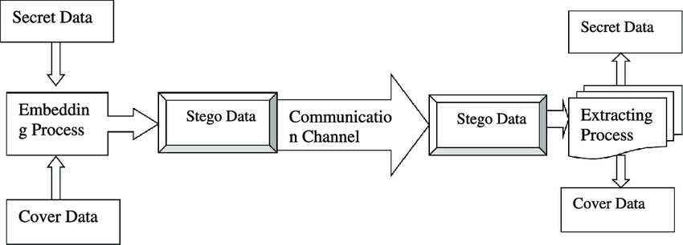
MODELLING
Step 1: importing some libraries like cv2 and os for accessing relevant concept into code.
Step 2: After converting the text into their ascii values then that ascii values are stored in variable.
Step 3: Read the image from it’s path and hiding the image using XOR operation , RGB mechanism
Step 4: A secret is created to avoid unauthorized users.
Step 5: To unhide the image user wants to enter the secret key.
Step 6: Finally, user can able to see the secret message.

Slide 11

WHO ARE THE END USERS of this project?
The primary end users for this steganography project include government and military personnel secure communication, corporate executives protecting proprietary data, and journalists sharing sensitive information discreetly.
IT and cyber security teams can integrate this technique to enhance organizational data security.
Additionally, the person who wants to send any secret message other person in a hidden format then this project will helpful for them.

Slide 12
Results
Enhanced security for sensitive information, making it difficult for unauthorized parties to detect or access hidden messages.
Increased awareness of data protection techniques among users, leading to more secure communication practices.
Successful implementation of steganography in various fields, including digital media, secure communications, and copyright protection.
Case studies demonstrating the effectiveness of steganography in real-world scenarios, such as secure messaging applications.

Slide 13
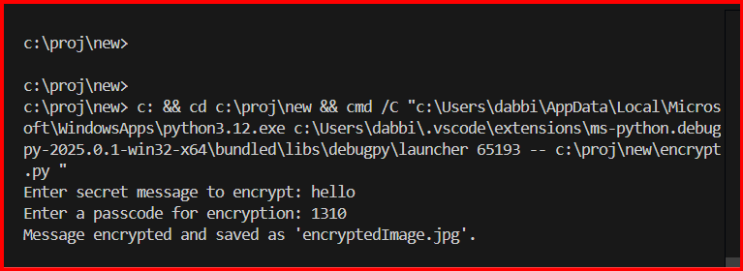
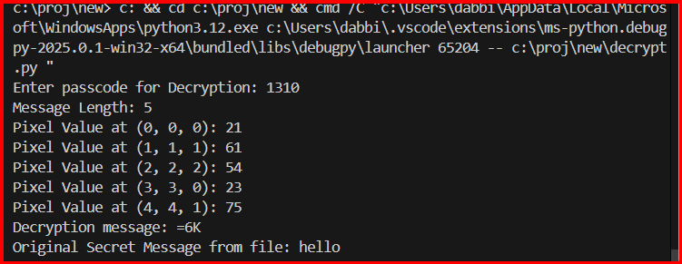

Slide 14
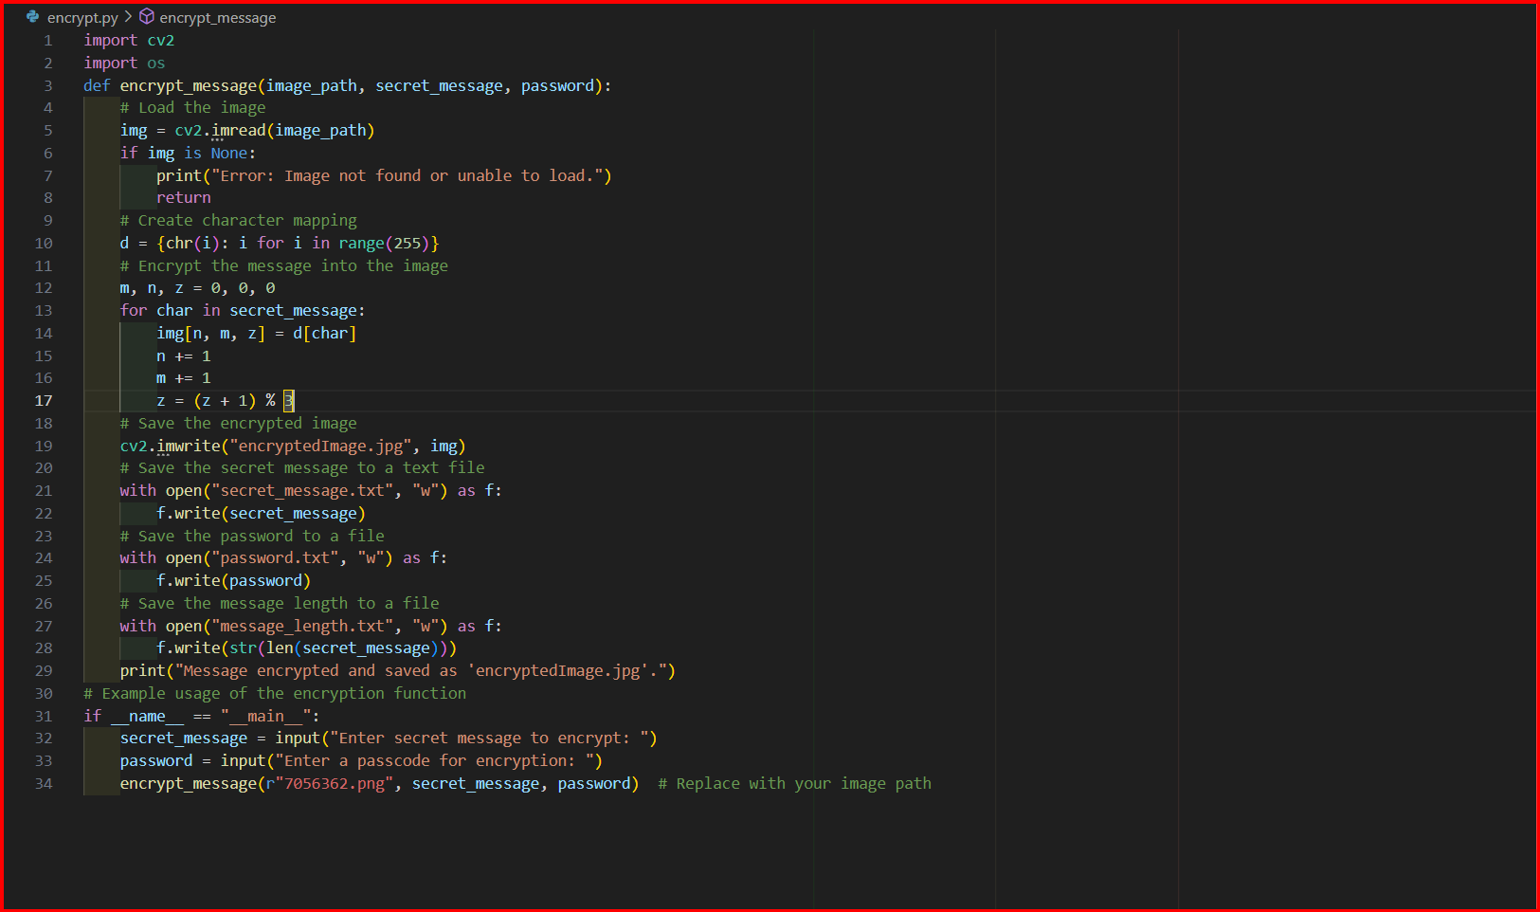
CODE FOR ENCRYPTION

Slide 15
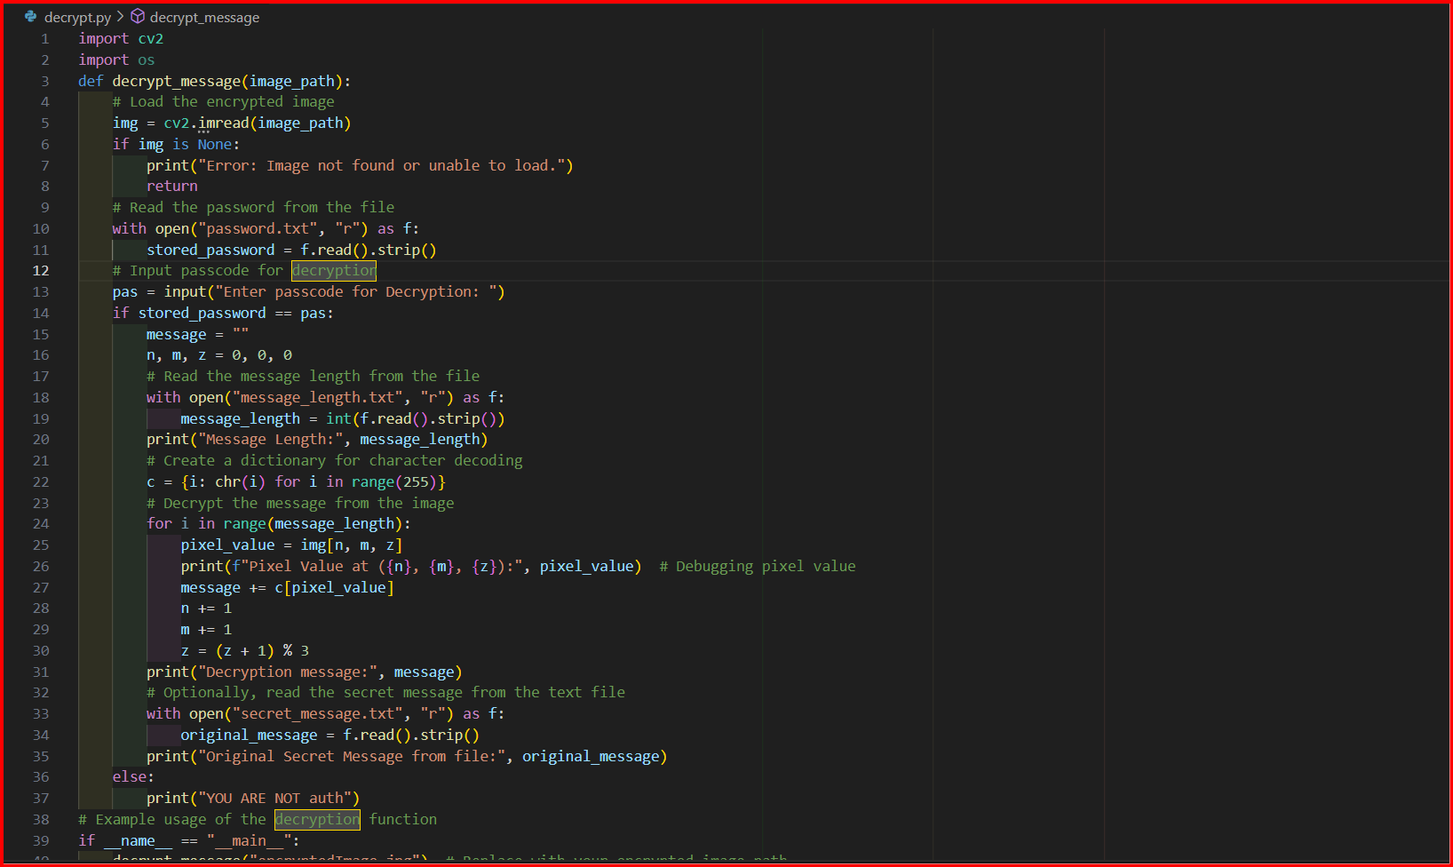
CODE FOR DECRYPTION

Slide 16


BEFORE ENCRYPTION
AFTER ENCRYPTION

Slide 17
Conclusion
Summary:
Steganography is a vital tool for ensuring privacy and security in digital communications.
Its applications are diverse, ranging from personal use to professional and governmental needs.
Final Thought:
As technology evolves, so will the methods and importance of steganography in safeguarding information.

Slide 18
GitHub Link
https://github.com/Vishal7842/AICTE-PROJECT.git

Slide 19
THANK YOU

